Slide 1
Bandeneon Playing Drones
Seyit Yiğit SIZLAYAN/1876861

Slide 2
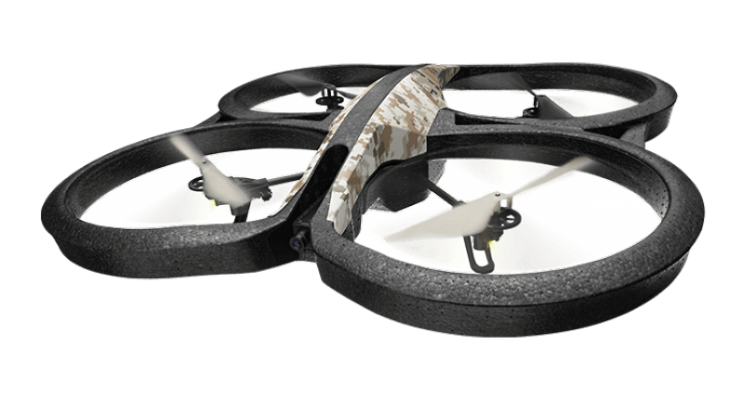
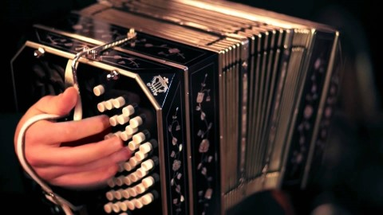
Purpose
2 Drones Playing Bandeneon

Slide 3
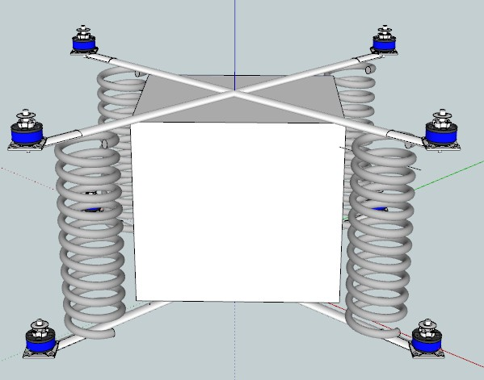
Quadrotor Kinematics
The drones are classical
90 degree-quadrotors
The bandeneon
Modeled as 4 springs
connected to end of rods

Slide 4
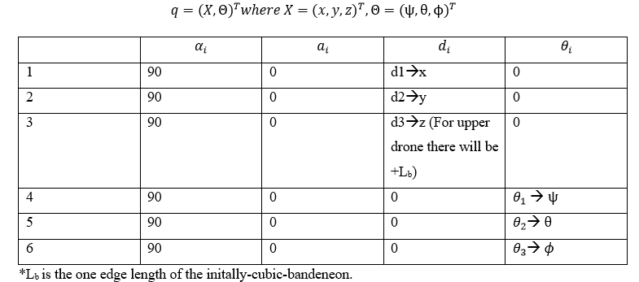

DH parameters
Resulting rotation matrix→

Slide 5
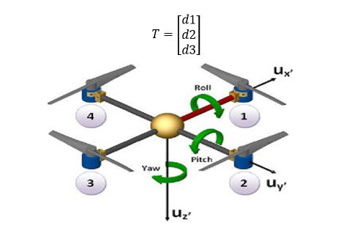
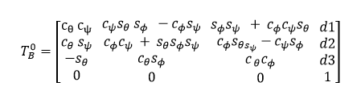
Body → World Rotation

Slide 6
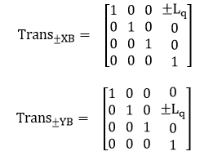

Propeller locations
→

Slide 7
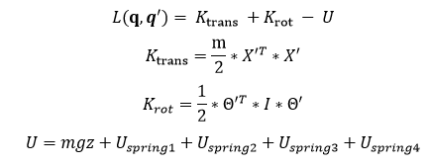
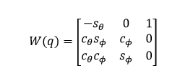
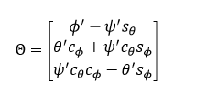


Dynamics-> Lagrangian
Rotational Jacobian →
Rotational Speed→
Inertia tensor→
Rotational Kinetic Energy→

Slide 8


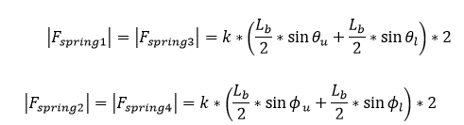

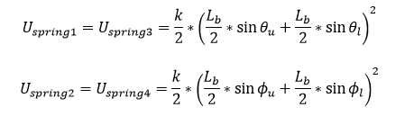
Forces and Torques
Motor Thrusts→
Torques→
Total pulling force with simplified spring
Spring Forces→
→
→
Spring potentials→

Slide 9
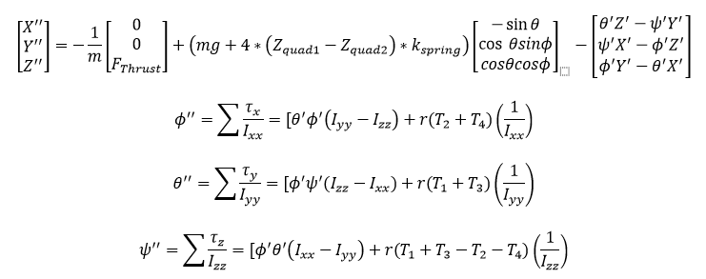
System Dynamic for One Drone

Slide 10

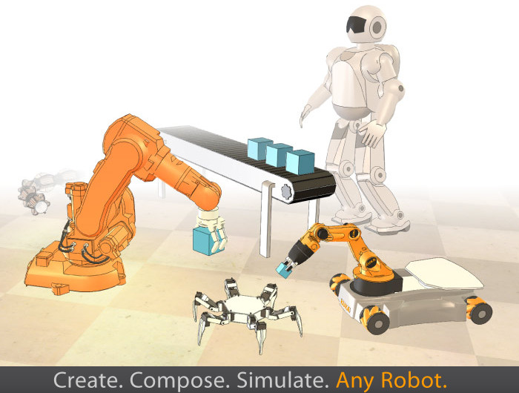

Control

Slide 11
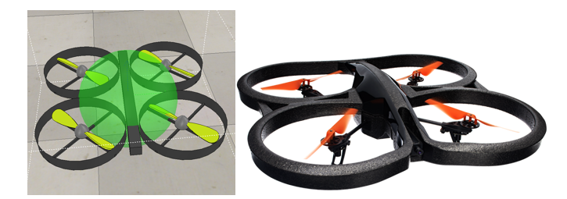
Quadrotor Model

Slide 12
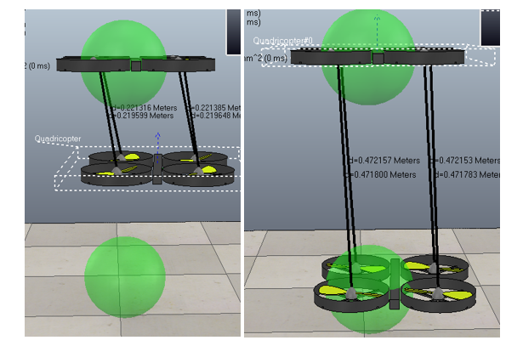
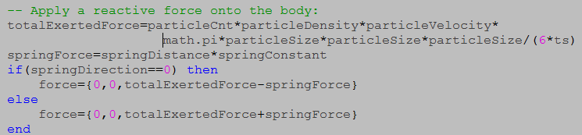
Adding Spring to Quadrotor Model

Slide 13
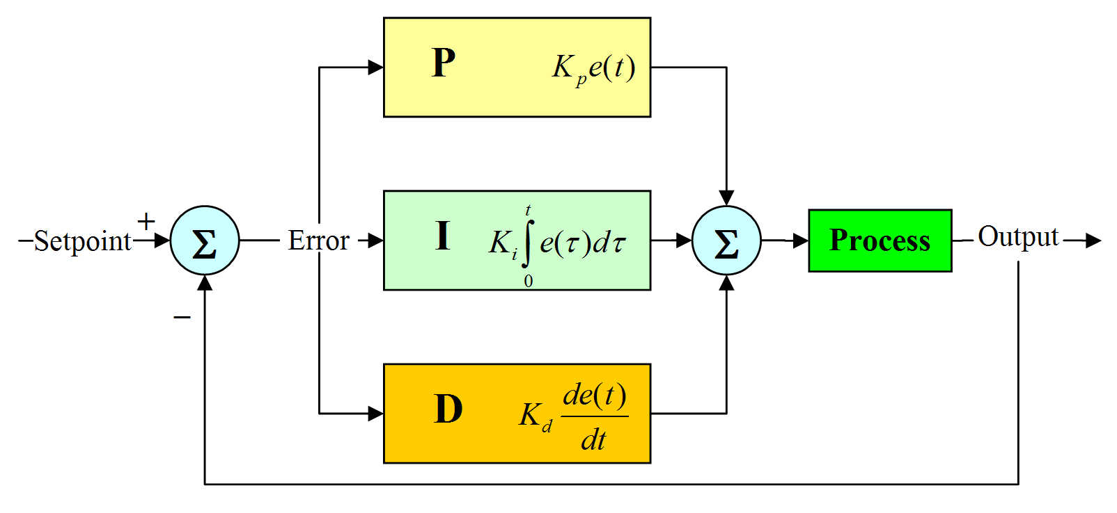
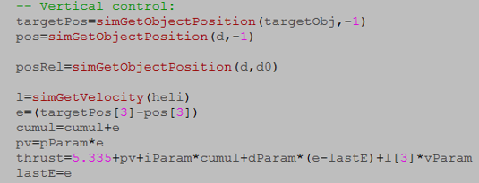
PID for Altitude control

Slide 14
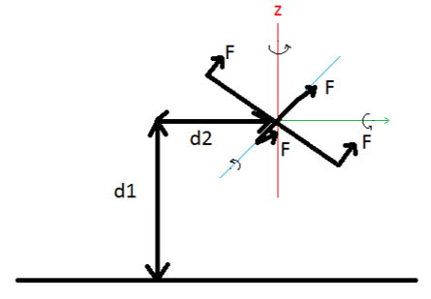
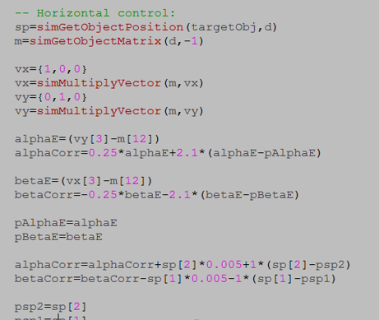
PID for Horizontal Velocity Control

Slide 15
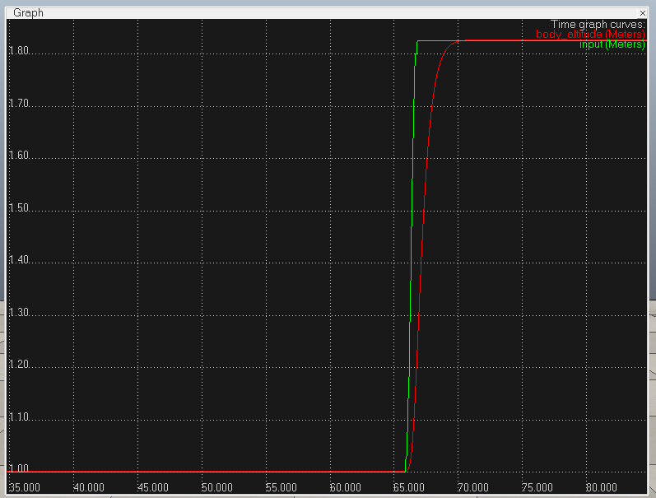
Responses
Altitude

Slide 16
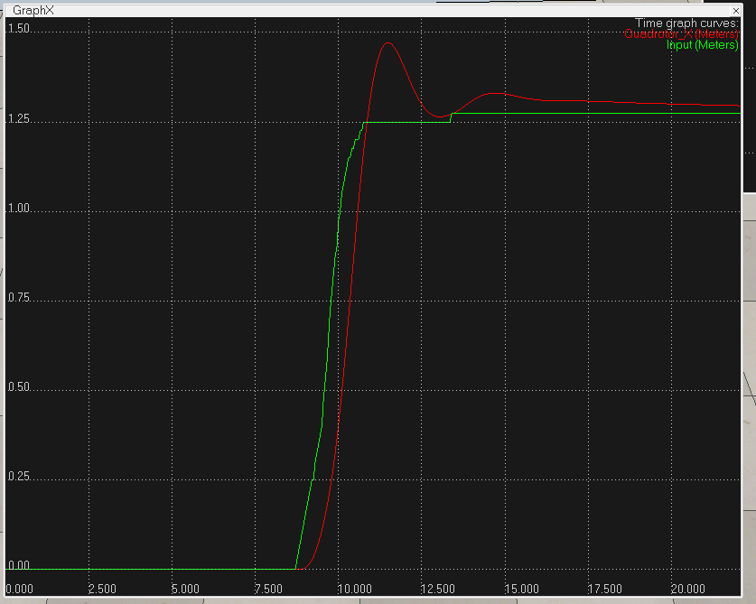
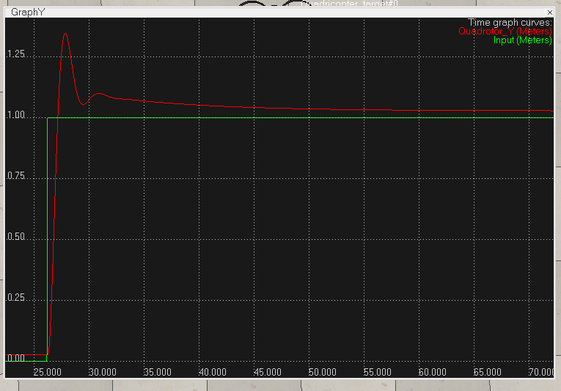
X
Y

Slide 17
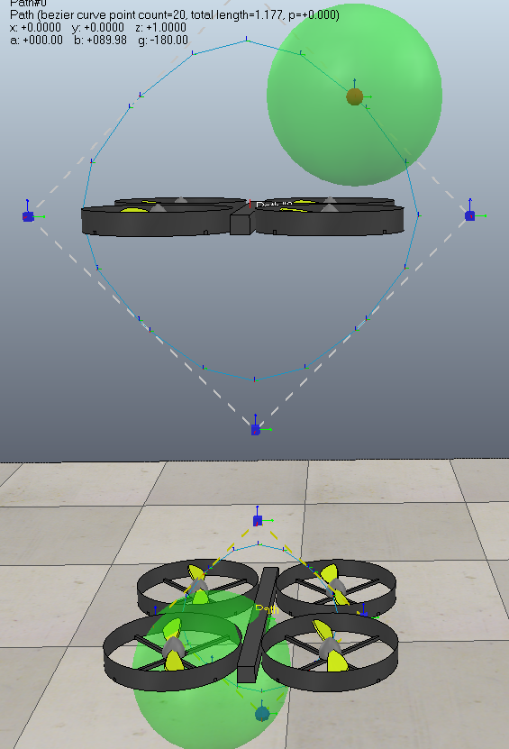
Path following
Path generated for bandeneon playing

Slide 18
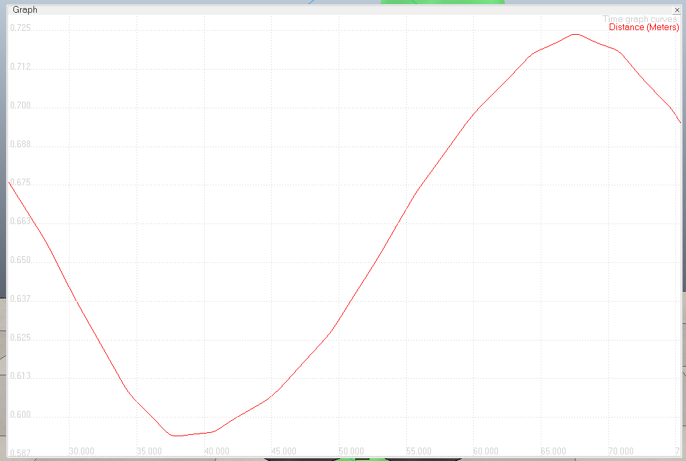
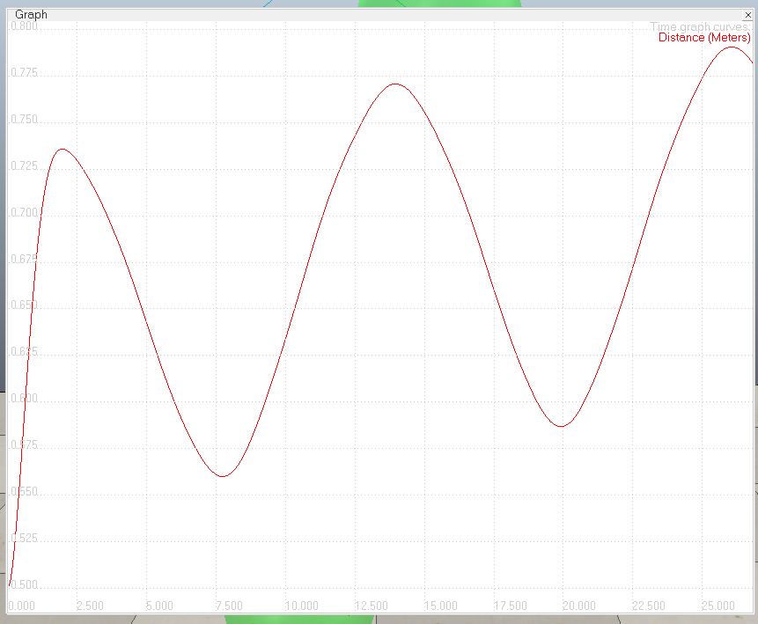
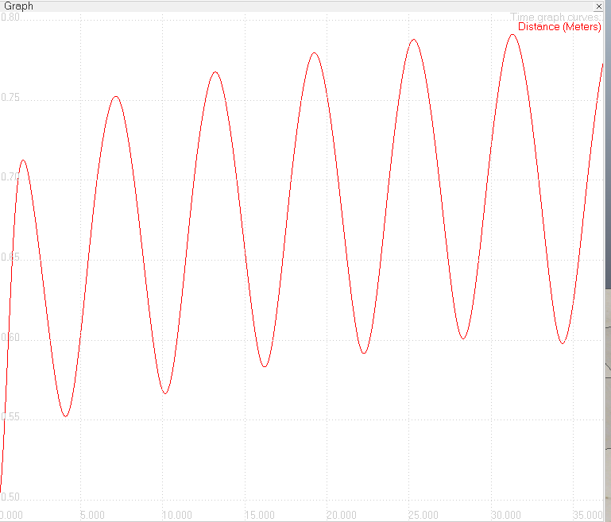
Resulting Outputs
High Period
Medium Period
Low Period

Slide 19
Simulation
I will take the questions after the simulation

Slide 20
Thanks ☺
All files related to this project can be found in:
https://github.com/sysizlayan/EE587_2016Fall_Project_YigitSIZLAYAN_1876861/

